Slide 1
Ch 9 –Scheduling (Uniprocessor)
NEU – 2017

Slide 2
Table 9.1
Types of Scheduling
Notes:
In a multiprogramming system, multiple processes exist concurrently in main memory.
Each process alternates between using a processor and waiting for some event
to occur, such as the completion of an I/O operation. The processor or processors
are kept busy by executing one process while the others wait.
The key to multiprogramming is scheduling. In fact, four types of scheduling are
typically involved (Table 9.1). One of these, I/O scheduling, is more conveniently addressed
in Chapter 11, where I/O is discussed. The remaining three types of scheduling,
which are types of processor scheduling, are addressed in this chapter and the next.
This chapter begins with an examination of the three types of processor scheduling,
showing how they are related. We see that long-term scheduling and mediumterm
scheduling are driven primarily by performance concerns related to the degree
of multiprogramming. These issues are dealt with to some extent in Chapter 3 and in
more detail in Chapters 7 and 8. Thus, the remainder of this chapter concentrates on
short-term scheduling and is limited to a consideration of scheduling on a uniprocessor
system. Because the use of multiple processors adds additional complexity, it
is best to focus on the uniprocessor case first, so that the differences among scheduling
algorithms can be clearly seen.

Slide 3
Notes:
Figure 9.1 relates the scheduling functions to the process state transition
diagram (first shown in Figure 3.9b ). Long-term scheduling is performed when a
new process is created. This is a decision whether to add a new process to the set
of processes that are currently active. Medium-term scheduling is a part of the
swapping function. This is a decision whether to add a process to those that are at
least partially in main memory and therefore available for execution. Short-term
scheduling is the actual decision of which ready process to execute next.

Slide 4
Notes:
Figure 9.2
reorganizes the state transition diagram of Figure 3.9b to suggest the nesting of
scheduling functions.

Slide 5
Notes:
Scheduling affects the performance of the system because it determines
which processes will wait and which will progress. This point of view is presented in
Figure 9.3 , which shows the queues involved in the state transitions of a process.
Fundamentally, scheduling is a matter of managing queues to minimize queuing
delay and to optimize performance in a queuing environment.

Slide 6
Short-Term Scheduling
Known as the dispatcher
Executes most frequently
Makes the fine-grained decision of which process to execute next
Invoked when an event occurs that may lead to the blocking of the current process or that may provide an opportunity to preempt a currently running process in favor of another
Examples:
Clock interrupts
I/O interrupts
Operating system calls
Signals (e.g., semaphores)
Notes:
In terms of frequency of execution, the long-term scheduler executes relatively
infrequently and makes the coarse-grained decision of whether or not to take on
a new process and which one to take. The medium-term scheduler is executed
somewhat more frequently to make a swapping decision. The short-term scheduler,
also known as the dispatcher, executes most frequently and makes the fine-grained
decision of which process to execute next.
The short-term scheduler is invoked whenever an event occurs that may lead
to the blocking of the current process or that may provide an opportunity to preempt
a currently running process in favor of another. Examples of such events include
• Clock interrupts
• I/O interrupts
• Operating system calls
• Signals (e.g., semaphores)

Slide 7
Short-Term Scheduling Criteria: Performance
Criteria can be classified into:
Performance-related
quantitative
easily measured
Non-performance related
qualitative
hard to measure
examples:
response time
throughput
example:
predictability
Notes:
Another dimension along which criteria can be classified is those that
are performance related and those that are not directly performance related.
Performance-related criteria are quantitative and generally can be readily measured.
Examples include response time and throughput. Criteria that are not
performance related are either qualitative in nature or do not lend themselves readily
to measurement and analysis. An example of such a criterion is predictability. We
would like for the service provided to users to exhibit the same characteristics over
time, independent of other work being performed by the system. To some extent,
this criterion can be measured by calculating variances as a function of workload.
However, this is not nearly as straightforward as measuring throughput or response
time as a function of workload.

Slide 8
Notes:
Table 9.2 summarizes key scheduling criteria. These are interdependent, and
it is impossible to optimize all of them simultaneously. For example, providing good
response time may require a scheduling algorithm that switches between processes
frequently. This increases the overhead of the system, reducing throughput. Thus,
the design of a scheduling policy involves compromising among competing requirements;
the relative weights given the various requirements will depend on the
nature and intended use of the system.
In most interactive operating systems, whether single user or time shared, adequate
response time is the critical requirement. Because of the importance of this
requirement, and because the definition of adequacy will vary from one application
to another, the topic is explored further in Appendix G .

Slide 9
Notes:
Table 9.2 summarizes key scheduling criteria. These are interdependent, and
it is impossible to optimize all of them simultaneously. For example, providing good
response time may require a scheduling algorithm that switches between processes
frequently. This increases the overhead of the system, reducing throughput. Thus,
the design of a scheduling policy involves compromising among competing requirements;
the relative weights given the various requirements will depend on the
nature and intended use of the system.
In most interactive operating systems, whether single user or time shared, adequate
response time is the critical requirement. Because of the importance of this
requirement, and because the definition of adequacy will vary from one application
to another, the topic is explored further in Appendix G .

Slide 10
Selection Function & Decision Mode
Determines which process, among ready processes, is selected next for execution
May be based on priority, resource requirements, or the execution characteristics of the process
If based on execution characteristics, then important quantities are:
w = time spent in system so far, waiting
e = time spent in execution so far
s = total service time required by the process, including e; generally, this quantity must be estimated or supplied by the user
Decision Mode
Preemptive/Non-preemptive
Turnaround Time (Tr) is service time + wait time
Normalized Turnaround Time (Tr / Ts) – ratio to actual service time
1.0 means no waiting
2.0 means waiting as long as it took to execute
Bigger values indicate additional wait time with respect to execution time
Notes:
The selection function determines which
process, among ready processes, is selected next for execution. The function may
be based on priority, resource requirements, or the execution characteristics of the
process. In the latter case, three quantities are significant:
w = time spent in system so far, waiting
e = time spent in execution so far
s = total service time required by the process, including e ; generally, this quantity
must be estimated or supplied by the user
For example, the selection function max[ w ] indicates an FCFS discipline.

Slide 11
First-Come-First-Served (FCFS)
Simplest scheduling policy
Also known as first-in-first-out (FIFO) or a strict queuing scheme
When the current process ceases to execute, the longest process in the Ready queue is selected
Performs much better for long processes than short ones
Tends to favor processor-bound processes over I/O-bound processes
Notes:
The simplest scheduling policy is first-come-first-served
(FCFS), also known as first-in-first-out (FIFO) or a strict queuing scheme.
As each process becomes ready, it joins the ready queue. When the currently
running process ceases to execute, the process that has been in the ready queue the
longest is selected for running.
FCFS performs much better for long processes than short ones.
Another difficulty with FCFS is that it tends to favor processor-bound processes
over I/O-bound processes. Consider that there is a collection of processes, one of
which mostly uses the processor (processor bound) and a number of which favor I/O
(I/O bound). When a processor-bound process is running, all of the I/O bound processes
must wait. Some of these may be in I/O queues (blocked state) but may move
back to the ready queue while the processor-bound process is executing. At this point,
most or all of the I/O devices may be idle, even though there is potentially work for
them to do. When the currently running process leaves the Running state, the ready
I/O-bound processes quickly move through the Running state and become blocked on
I/O events. If the processor-bound process is also blocked, the processor becomes idle.
Thus, FCFS may result in inefficient use of both the processor and the I/O devices.
FCFS is not an attractive alternative on its own for a uniprocessor system.
However, it is often combined with a priority scheme to provide an effective scheduler.
Thus, the scheduler may maintain a number of queues, one for each priority
level, and dispatch within each queue on a first-come-first-served basis. We see one
example of such a system later, in our discussion of feedback scheduling.

Slide 12
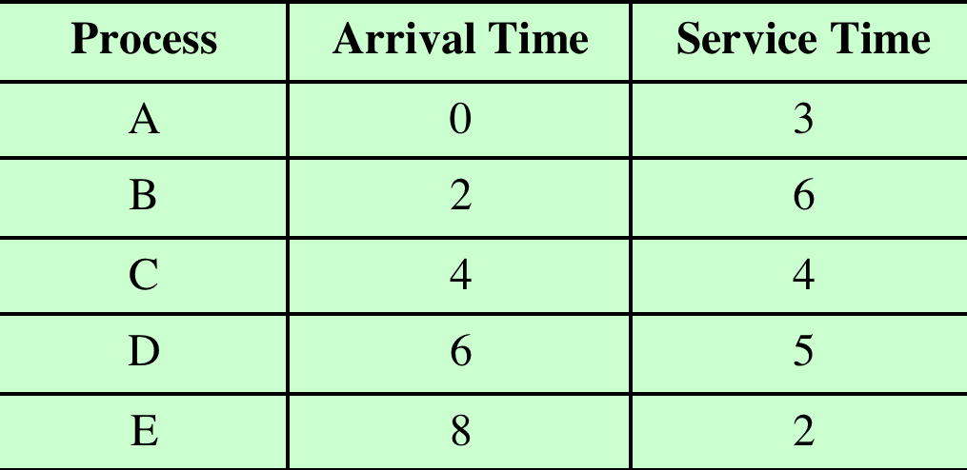
Notes:
As we describe the various scheduling policies, we will use the set of processes
in Table 9.4 as a running example. We can think of these as batch jobs, with the
service time being the total execution time required. Alternatively, we can consider
these to be ongoing processes that require alternate use of the processor and I/O
in a repetitive fashion. In this latter case, the service times represent the processor
time required in one cycle. In either case, in terms of a queuing model, this quantity
corresponds to the service time.

Slide 13
Round Robin
Uses preemption based on a clock
Also known as time slicing because each process is given a slice of time before being preempted
Principal design issue is the length of the time quantum, or slice, to be used
Particularly effective in a general-purpose time-sharing system or transaction processing system
One drawback is its relative treatment of processor-bound and I/O-bound processes
Notes:
A straightforward way to reduce the penalty that short jobs suffer
with FCFS is to use preemption based on a clock. The simplest such policy is round
robin. A clock interrupt is generated at periodic intervals. When the interrupt
occurs, the currently running process is placed in the ready queue, and the next
ready job is selected on a FCFS basis. This technique is also known as time slicing ,
because each process is given a slice of time before being preempted.
With round robin, the principal design issue is the length of the time quantum,
or slice, to be used. If the quantum is very short, then short processes will move
through the system relatively quickly. On the other hand, there is processing overhead
involved in handling the clock interrupt and performing the scheduling and
dispatching function. Thus, very short time quanta should be avoided.
Round robin is particularly effective in a general-purpose time-sharing system
or transaction processing system. One drawback to round robin is its relative
treatment of processor-bound and I/O-bound processes. Generally, an I/O-bound
process has a shorter processor burst (amount of time spent executing between I/O
operations) than a processor-bound process. If there is a mix of processor-bound
and I/O-bound processes, then the following will happen: An I/O-bound process
uses a processor for a short period and then is blocked for I/O; it waits for the
I/O operation to complete and then joins the ready queue. On the other hand, a
processor-bound process generally uses a complete time quantum while executing
and immediately returns to the ready queue. Thus, processor-bound processes
tend to receive an unfair portion of processor time, which results in poor performance
for I/O-bound processes, inefficient use of I/O devices, and an increase in the
variance of response time.

Slide 14
Notes:
As we describe the various scheduling policies, we will use the set of processes
in Table 9.4 as a running example. We can think of these as batch jobs, with the
service time being the total execution time required. Alternatively, we can consider
these to be ongoing processes that require alternate use of the processor and I/O
in a repetitive fashion. In this latter case, the service times represent the processor
time required in one cycle. In either case, in terms of a queuing model, this quantity
corresponds to the service time.

Slide 15
Shortest Process Next (SPN)
Need to know the required processing time of each process
Estimate …?
If estimate is substantially under actual running time, the system may abort the job
Nonpreemptive policy
Shortest expected processing time is selected next
Possibility of starvation for longer processes
Notes:
Another approach to reducing the bias in favor of
long processes inherent in FCFS is the shortest process next (SPN) policy. This is
a nonpreemptive policy in which the process with the shortest expected processing
time is selected next. Thus, a short process will jump to the head of the queue past
longer jobs.
Figure 9.5 and Table 9.5 show the results for our example. Note that process
E receives service much earlier than under FCFS. Overall performance is also significantly
improved in terms of response time. However, the variability of response
times is increased, especially for longer processes, and thus predictability is reduced.
One difficulty with the SPN policy is the need to know or at least estimate the
required processing time of each process. For batch jobs, the system may require the
programmer to estimate the value and supply it to the operating system. If the programmer’s
estimate is substantially under the actual running time, the system may abort the
job. In a production environment, the same jobs run frequently, and statistics may be
gathered. For interactive processes, the operating system may keep a running average
of each “burst” for each process.
A risk with SPN is the possibility of starvation for longer processes, as long
as there is a steady supply of shorter processes. On the other hand, although SPN
reduces the bias in favor of longer jobs, it still is not desirable for a time-sharing or
transaction processing environment because of the lack of preemption. Looking
back at our worst-case analysis described under FCFS, processes W, X, Y, and Z
will still execute in the same order, heavily penalizing the short process Y.

Slide 16
Notes:
The size of the coefficient as a function of its position in the expansion is shown
in Figure 9.8 . The larger the value of , the greater is the weight given to the more
recent observations. For α= 0.8, virtually all of the weight is given to the four most
recent observations, whereas for α = 0.2, the averaging is effectively spread out over
the eight or so most recent observations. The advantage of using a value of close
to 1 is that the average will quickly reflect a rapid change in the observed quantity.
The disadvantage is that if there is a brief surge in the value of the observed quantity
and it then settles back to some average value, the use of a large value of α will
result in jerky changes in the average.

Slide 17
Notes:
Figure 9.9 compares simple averaging with exponential averaging (for two different values of α).
Here (Figure 9.9a), the observed value begins at 1, grows gradually to a value of 10, and then stays there.

Slide 18
Notes:
While here (Figure 9.9b), the observed value begins at 20, declines gradually to 10, and then stays there.
In both cases, we start out with an estimate of S₁ = 0.
This gives greater priority to new processes.
Note that exponential averaging tracks changes in process behavior faster than does simple averaging and that the larger value of α results in a more rapid reaction to the change in the observed value.

Slide 19
Notes:
As we describe the various scheduling policies, we will use the set of processes
in Table 9.4 as a running example. We can think of these as batch jobs, with the
service time being the total execution time required. Alternatively, we can consider
these to be ongoing processes that require alternate use of the processor and I/O
in a repetitive fashion. In this latter case, the service times represent the processor
time required in one cycle. In either case, in terms of a queuing model, this quantity
corresponds to the service time.

Slide 20
Shortest Remaining Time (SRT)
Preemptive version of SPN
Scheduler always chooses the process that has the shortest expected remaining processing time
Risk of starvation of longer processes
Should give superior turnaround time performance to SPN because a short job is given immediate preference to a running longer job
Notes:
The shortest remaining time (SRT) policy is a
preemptive version of SPN. In this case, the scheduler always chooses the process
that has the shortest expected remaining processing time. When a new process joins
the ready queue, it may in fact have a shorter remaining time than the currently
running process. Accordingly, the scheduler may preempt the current process when
a new process becomes ready. As with SPN, the scheduler must have an estimate of
processing time to perform the selection function, and there is a risk of starvation of
longer processes.
SRT does not have the bias in favor of long processes found in FCFS. Unlike
round robin, no additional interrupts are generated, reducing overhead. On the
other hand, elapsed service times must be recorded, contributing to overhead. SRT
should also give superior turnaround time performance to SPN, because a short job
is given immediate preference to a running longer job.
Note that in our example ( Table 9.5 ), the three shortest processes all receive
immediate service, yielding a normalized turnaround time for each of 1.0.

Slide 21
Notes:
As we describe the various scheduling policies, we will use the set of processes
in Table 9.4 as a running example. We can think of these as batch jobs, with the
service time being the total execution time required. Alternatively, we can consider
these to be ongoing processes that require alternate use of the processor and I/O
in a repetitive fashion. In this latter case, the service times represent the processor
time required in one cycle. In either case, in terms of a queuing model, this quantity
corresponds to the service time.

Slide 22

Highest Response Ratio Next (HRRN)
Chooses next process with the greatest ratio
Attractive because it accounts for the age of the process
While shorter jobs are favored, aging without service increases the ratio so that a longer process will eventually get past competing shorter jobs
Notes:
In Table 9.5 , we have used the normalized
turnaround time, which is the ratio of turnaround time to actual service time, as a
figure of merit. For each individual process, we would like to minimize this ratio,
and we would like to minimize the average value over all processes. In general,
we cannot know ahead of time what the service time is going to be, but we can
approximate it, either based on past history or some input from the user or a
configuration manager.
Thus, our scheduling rule becomes the following: when the current process
completes or is blocked, choose the ready process with the greatest value of R .
This approach is attractive because it accounts for the age of the process. While
shorter jobs are favored (a smaller denominator yields a larger ratio), aging without
service increases the ratio so that a longer process will eventually get past competing
shorter jobs.
As with SRT and SPN, the expected service time must be estimated to use
highest response ratio next (HRRN).

Slide 23
Notes:
As we describe the various scheduling policies, we will use the set of processes
in Table 9.4 as a running example. We can think of these as batch jobs, with the
service time being the total execution time required. Alternatively, we can consider
these to be ongoing processes that require alternate use of the processor and I/O
in a repetitive fashion. In this latter case, the service times represent the processor
time required in one cycle. In either case, in terms of a queuing model, this quantity
corresponds to the service time.

Slide 24
Notes:
Figure 9.10 illustrates the feedback scheduling mechanism by showing the
path that a process will follow through the various queues. This approach is known
as multilevel feedback , meaning that the operating system allocates the processor
to a process and, when the process blocks or is preempted, feeds it back into one of
several priority queues.

Slide 25
Notes:
As we describe the various scheduling policies, we will use the set of processes
in Table 9.4 as a running example. We can think of these as batch jobs, with the
service time being the total execution time required. Alternatively, we can consider
these to be ongoing processes that require alternate use of the processor and I/O
in a repetitive fashion. In this latter case, the service times represent the processor
time required in one cycle. In either case, in terms of a queuing model, this quantity
corresponds to the service time.

Slide 26
Table 9.3
Characteristics of Various Scheduling Policies
(Table can be found on page 405 in textbook)
Notes:
Table 9.3 presents some summary information about the various scheduling policies
that are examined in this subsection

Slide 27
Table 9.5
A Comparison
of Scheduling Policies
(Table is on page 408 in textbook)
Notes:
Figure 9.5 and Table 9.5 show the results for our example using time quanta q
of 1 and 4 time units. Note that process E, which is the shortest job, enjoys significant
improvement for a time quantum of 1.

Slide 28
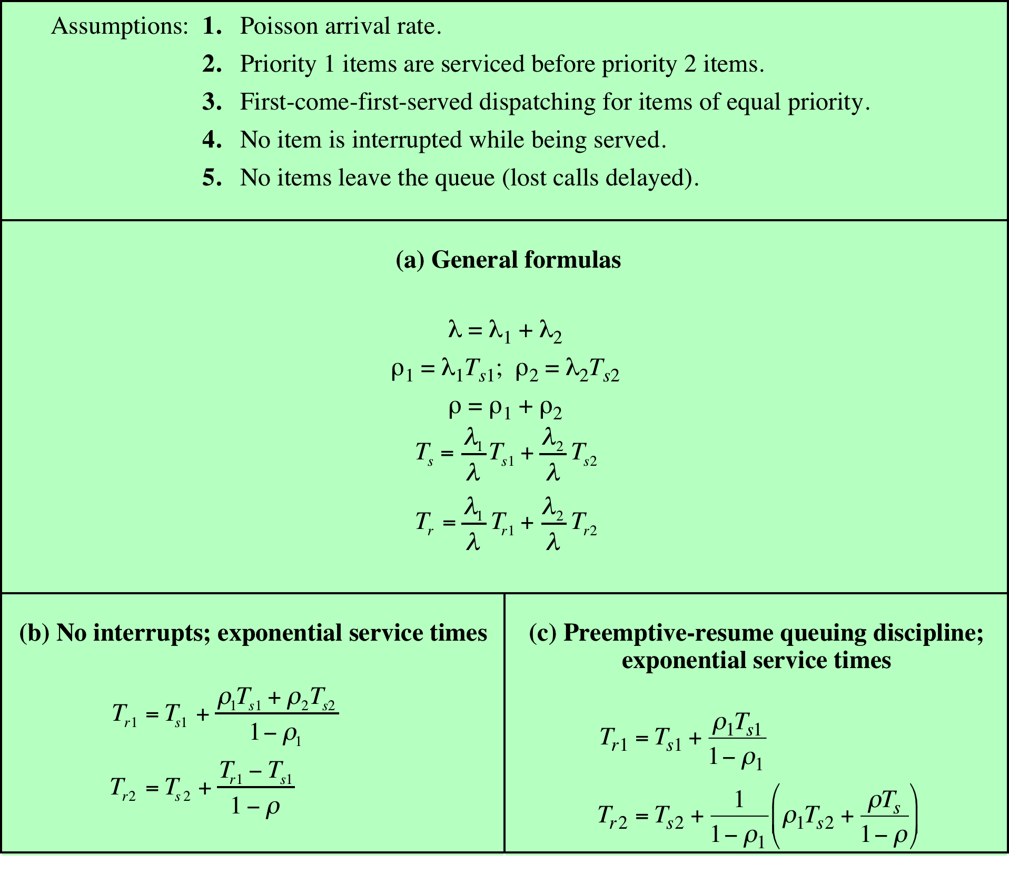
Table 9.6
Formulas
for Single-Server Queues
with Two Priority Categories
Notes:
If scheduling is done on the basis of priority and if processes are assigned to
a priority class on the basis of service time, then differences do emerge. Table 9.6
shows the formulas that result when we assume two priority classes, with different
service times for each class. In the table, refers to the arrival rate. These results can
be generalized to any number of priority classes. Note that the formulas differ for
nonpreemptive versus preemptive scheduling. In the latter case, it is assumed that
a lower-priority process is immediately interrupted when a higher-priority process
becomes ready.

Slide 29
Notes:
As an example, let us consider the case of two priority classes, with an equal
number of process arrivals in each class and with the average service time for the
lower-priority class being five times that of the upper priority class. Thus, we wish to
give preference to shorter processes. Figure 9.11 shows the overall result. By giving
preference to shorter jobs, the average normalized turnaround time is improved
at higher levels of utilization. As might be expected, the improvement is greatest
with the use of preemption. Notice, however, that overall performance is not much
affected.

Slide 30
Notes:
Figure 9.13 shows the same analysis for the lower-priority, longer processes.
As expected, such processes suffer a performance degradation under priority
scheduling.

Slide 31
Notes:
However, significant differences emerge when we consider the two priority
classes separately. Figure 9.12 shows the results for the higher-priority, shorter
processes. For comparison, the upper line on the graph assumes that priorities are
not used but that we are simply looking at the relative performance of that half of
all processes that have the shorter processing time. The other two lines assume that
these processes are assigned a higher priority. When the system is run using priority
scheduling without preemption, the improvements are significant. They are even
more significant when preemption is used.

Slide 32
Notes:
Some of the difficulties of analytic modeling are
overcome by using discrete-event simulation, which allows a wide range of policies
to be modeled. The disadvantage of simulation is that the results for a given “run”
only apply to that particular collection of processes under that particular set of
assumptions. Nevertheless, useful insights can be gained.
The results of one such study are reported in [FINK88]. The simulation
involved 50,000 processes with an arrival rate of λ = 0.8 and an average service time
of T _{s} = 1. Thus, the assumption is that the processor utilization is ρ = λT _{s} = 0.8.
Note, therefore, that we are only measuring one utilization point.
To present the results, processes are grouped into service-time percentiles,
each of which has 500 processes. Thus, the 500 processes with the shortest service
time are in the first percentile; with these eliminated, the 500 remaining processes
with the shortest service time are in the second percentile; and so on. This allows
us to view the effect of various policies on processes as a function of the length of
the process.
Figure 9.14 shows the normalized turnaround time.

Slide 33
Notes:
Figure 9.15 shows
the average waiting time. Looking at the turnaround time, we can see that the
performance of FCFS is very unfavorable, with one-third of the processes having
a normalized turnaround time greater than 10 times the service time; furthermore,
these are the shortest processes. On the other hand, the absolute waiting time is
uniform, as is to be expected because scheduling is independent of service time.
The figures show round robin using a quantum of one time unit. Except for the
shortest processes, which execute in less than one quantum, round robin yields
a normalized turnaround time of about five for all processes, treating all fairly.
Shortest process next performs better than round robin, except for the shortest
processes. Shortest remaining time, the preemptive version of SPN, performs better
than SPN except for the longest 7% of all processes. We have seen that, among
nonpreemptive policies, FCFS favors long processes and SPN favors short ones.
Highest response ratio next is intended to be a compromise between these two
effects, and this is indeed confirmed in the figures. Finally, the figure shows feedback
scheduling with fixed, uniform quanta in each priority queue. As expected,
FB performs quite well for short processes.

Slide 34
Fair-Share Scheduling
Scheduling decisions based on the process sets
Time slicing across process sets
Each user is assigned a share of the processor
Objective is to monitor usage to give fewer resources to users who have had more than their fair share and more to those who have had less than their fair share
Notes:
All of the scheduling algorithms discussed so far treat the collection of ready
processes as a single pool of processes from which to select the next running process.
This pool may be broken down by priority but is otherwise homogeneous.
However, in a multiuser system, if individual user applications or jobs may be
organized as multiple processes (or threads), then there is a structure to the collection
of processes that is not recognized by a traditional scheduler. From the user’s
point of view, the concern is not how a particular process performs but rather how
his or her set of processes, which constitute a single application, performs. Thus, it
would be attractive to make scheduling decisions on the basis of these process sets.
This approach is generally known as fair-share scheduling. Further, the concept can
be extended to groups of users, even if each user is represented by a single process.
For example, in a time-sharing system, we might wish to consider all of the users
from a given department to be members of the same group. Scheduling decisions
could then be made that attempt to give each group similar service. Thus, if a large
number of people from one department log onto the system, we would like to see
response time degradation primarily affect members of that department rather than
users from other departments.
The term fair share indicates the philosophy behind such a scheduler. Each
user is assigned a weighting of some sort that defines that user’s share of system
resources as a fraction of the total usage of those resources. In particular, each
user is assigned a share of the processor. Such a scheme should operate in a more
or less linear fashion, so that if user A has twice the weighting of user B, then in
the long run, user A should be able to do twice as much work as user B. The objective
of a fair-share scheduler is to monitor usage to give fewer resources to users
who have had more than their fair share and more to those who have had less than
their fair share.

Slide 35
Notes:
Figure 9.16 is an example in which process A is in one group and processes B
and C are in a second group, with each group having a weighting of 0.5. Assume that
all processes are processor bound and are usually ready to run. All processes have
a base priority of 60. Processor utilization is measured as follows: The processor is
interrupted 60 times per second; during each interrupt, the processor usage field of
the currently running process is incremented, as is the corresponding group processor
field. Once per second, priorities are recalculated.
In the figure, process A is scheduled first. At the end of one second, it is
preempted. Processes B and C now have the higher priority, and process B is scheduled.
At the end of the second time unit, process A has the highest priority. Note
that the pattern repeats: the kernel schedules the processes in order: A, B, A, C, A,
B, and so on. Thus, 50% of the processor is allocated to process A, which constitutes
one group, and 50% to processes B and C, which constitute another group.

